Slide 1
Exploring the Relationship Between Movie Budgets and Popularity by Python
By: Krushna Satyanarayan Takey
From: Niit

Slide 2
Objective :-
To investigate the relationship between movie popularity and budget.
To determine whether there is a correlation between movie popularity and budget.
To analyze the impact of movie budgets on popularity.
To explore the factors that contribute to the popularity of movies.
To provide insights for filmmakers and movie studios on how to produce popular movies.

Slide 3
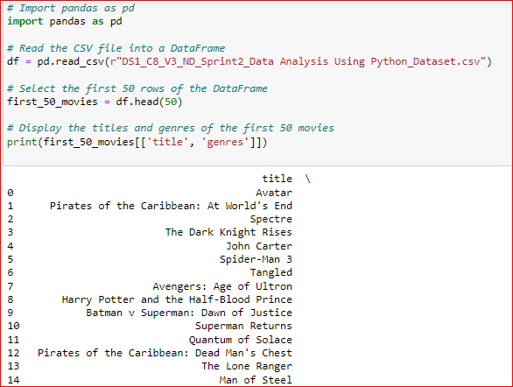
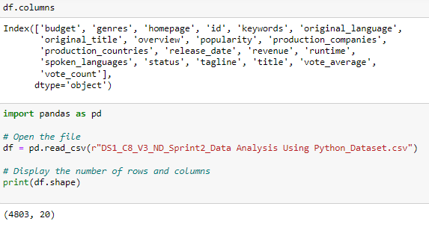
Task – 1:
Load the movie dataset in the Python notebook. Display the numbers of rows and columns in the dataset. Display the titles and genres of the first 50 movies from the dataset.

Slide 4
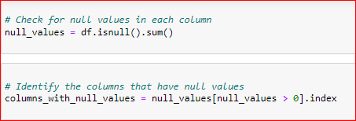
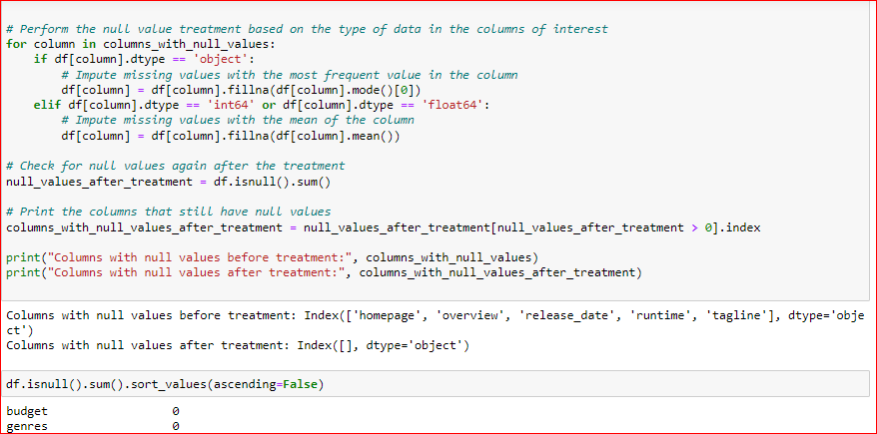
Task-2: Identify the columns that have null values and perform the null value treatment. (Choose the imputation method based on the type of data in the columns of interest)

Slide 5
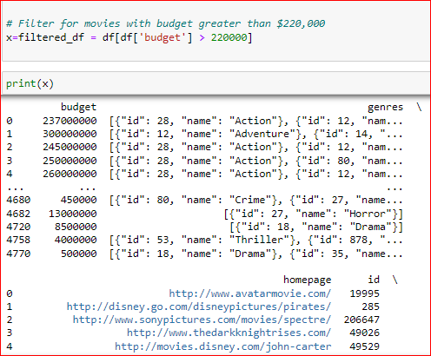
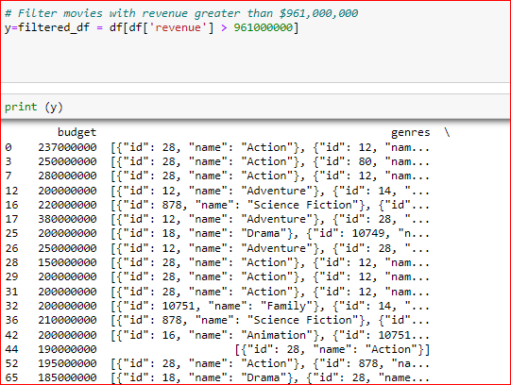
Task -3: Display the movie categories that have a budget greater than $220,000.
Task - 4: Display the movie categories where the revenue is greater than $961,000,000.
3. 4.

Slide 6
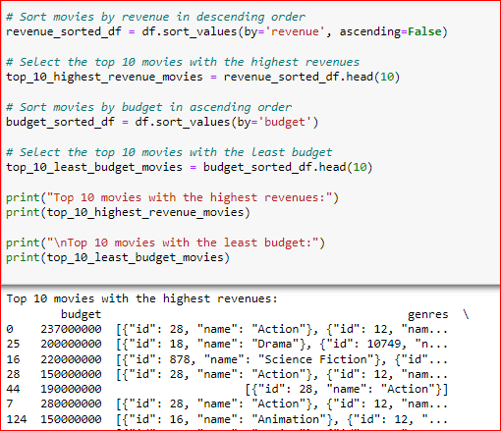
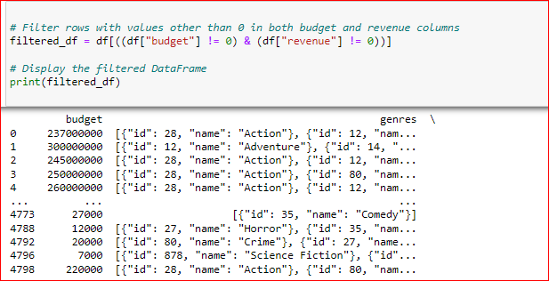
Task-5: In the dataset, there are some movies for which the budget and revenue columns have thevalue 0, which mean unknown values. Remove the rows with value 0 from both the budget and revenue columns.
Task - 6: List the top 10 movies with the highest revenues and the top 10 movies with the least budget.
6.
5.

Slide 7
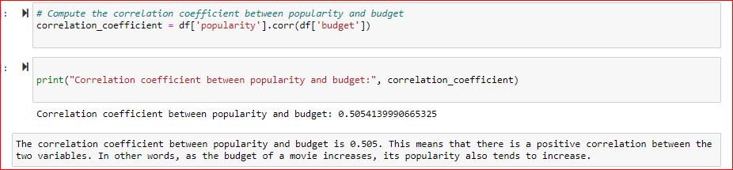
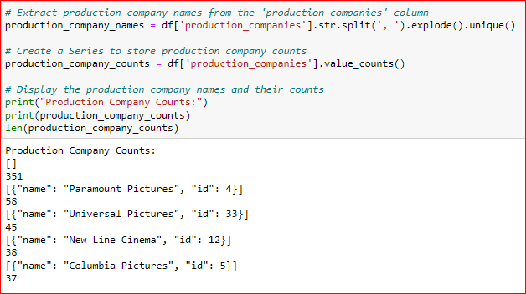
Task-7: How are popularities of movies related with the movie budgets? Are they correlated or totally uncorrelated with each other? Write the interpretation of your analysis.
Task-8: Identify and display the names of all production companies along with the number of times they appear in the dataset.

Slide 8
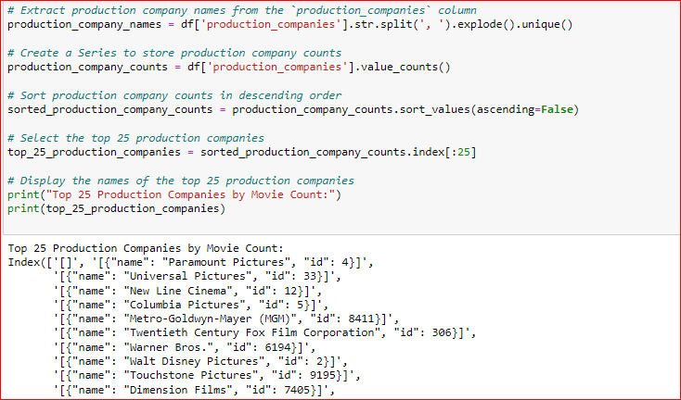
Task-9: Display the names of the top 25 production companies based on the number of movies they have produced in descending order of the number of movies produced.
Task-10: Sort the data in descending order based on revenue and filter the top 500 movies. Find the measures of central tendency for the following columns using the filtered data:1. budget2. revenue3. runtime Perform outlier analysis for the above three columns using box plots. Link

Slide 9
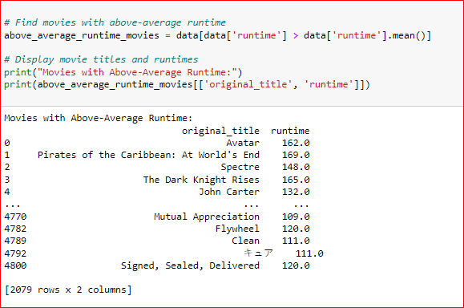
Task-11: Identify and display the names of the movies along with their run times for those movies that have above average runtime, using the data from the previous task.
Link

Slide 10
Conclusion:- Movie budgets and popularity are positively correlated, meaning that movies with larger budgets are generally more popular.
While this doesn't necessarily mean that larger budgets cause greater popularity, it does suggest that financial resources play a significant role in a movie's success.
Link

Slide 11
Thank You.

